Slide 1
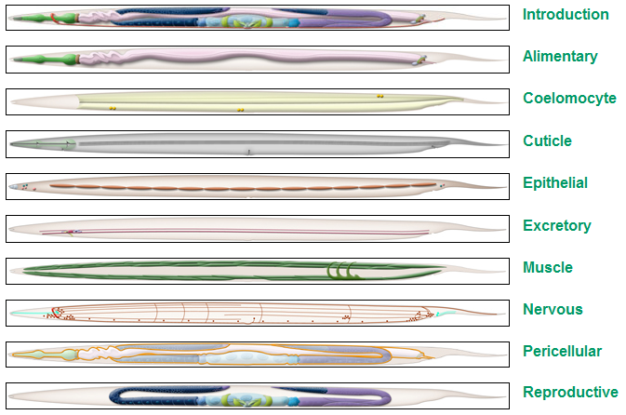

Some fragments of information, showing the complexity of C. elegans
at different hierarchical levels. Facts, images, examples, links
What systems are first-priority (primary) for simulation?
I’ve collected some statistics about number of cells forming each system:
total cells:
959
whole worm
127
?
6
?
0
30
?
8
?
95+85
302+56
0
?
76+25
?
checksum:
810
(what’s missing?)
Open Worm 2011
Andrey Palyanov
Notes:
Muscular system: 95 (somatic muscle cells) + 85 (nonstriated muscles, GLR cells, head mesodermal cells)
Reproductive system: 76 (somatic gonads) + 25 (egg-laying apparatus)
Nervous system: 302 (nervous cells) + 56 (support cells)

Slide 2
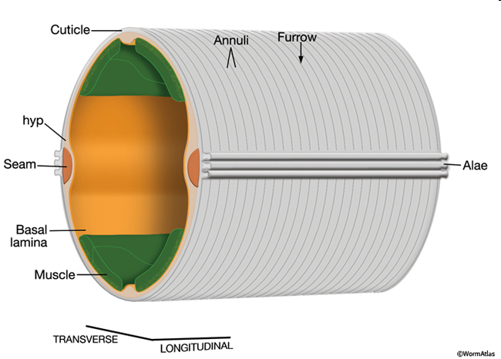
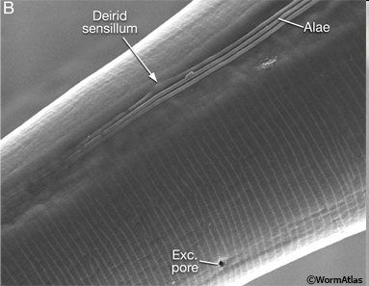
The outer surface of the animal is covered by a tough, but flexible, extracellular cuticle. This cuticle protects the animal from the environment, maintains body shape, and permits motility by acting as an external skeleton. The cuticle is secreted by the epithelial cells covering the body (hypodermis, seam cells) and by interfacial cells lining the four major openings to the exterior. The cuticle surface is covered with a surface coat (glycocalyx) that is thought to be secreted by gland cells (the excretory cell, pharyngeal gland cells, or the amphid and phasmid support cells)
The elasticity of the cuticle and the animal's high internal hydrostatic pressure provide the restorative force that allows the animal to straighten after contracting muscles on one side of the body (like a water-filled balloon). The cuticle is a highly complex extracellular structure, presumably due to the many functions it must perform.

Slide 3

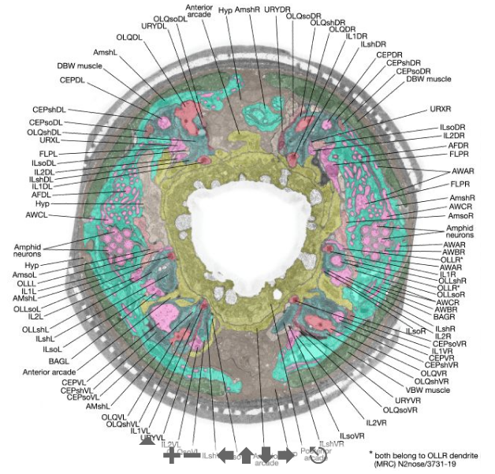
The complexity of just the head tip
All of the cells found in the anterior 10 μm of C. elegans' head (1/100 part of 1 mm worm) are summarized in table. The non-neuronal cells were identified easily by their positions and morphology. The neurons were identified by synaptic connections in the central nervous system. Most of the neurons can also be recognized just by the fine structure of their anterior terminals.
Slidable Worm - WormViewer
Slice #8/798
Cell type | Number
Muscle | 8
Hypodermal | 8
Labial Epidermal Arcade | 6 9
Sheath | 18
Socket | 18
Neuron | 58
Total cells | 125
Notes:
http://www.wormatlas.org/ver1/ward_buildv0.1/results.html

Slide 4
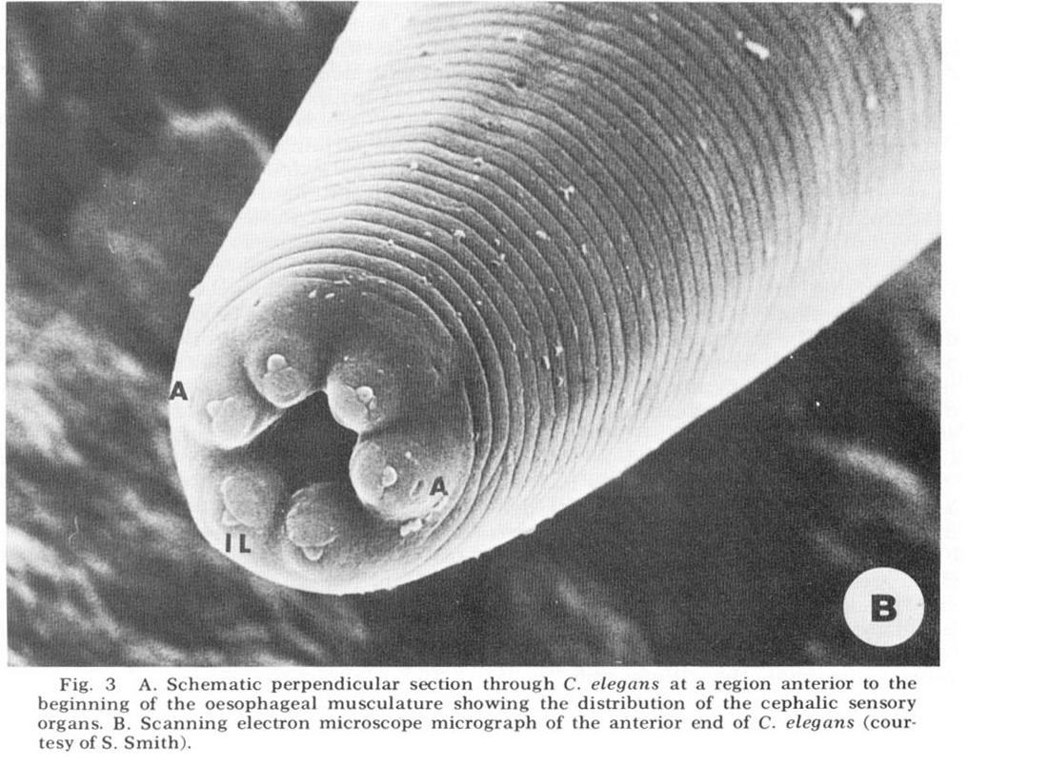
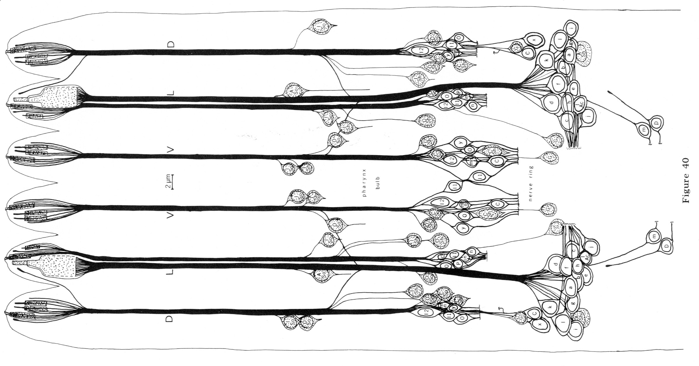
← Microphotograph of C. elegans anterior end
Anterior nerve cords and sensilla cell bodies. The nerve cords and cell bodies of all cells which have processes in the anterior nerve cords are shown. They are drawn as if projected radially onto a cylinder through the length of the worm and the cylinder were cut along the mid-dorsal line and unrolled.
Notes:
Worm head. Image sources:
http://www.wormatlas.org/ver1/Ware_build0.2/observations1.html
http://www.wormatlas.org/ver1/ward_buildv0.1/art/fig40_large.jpg

Slide 5
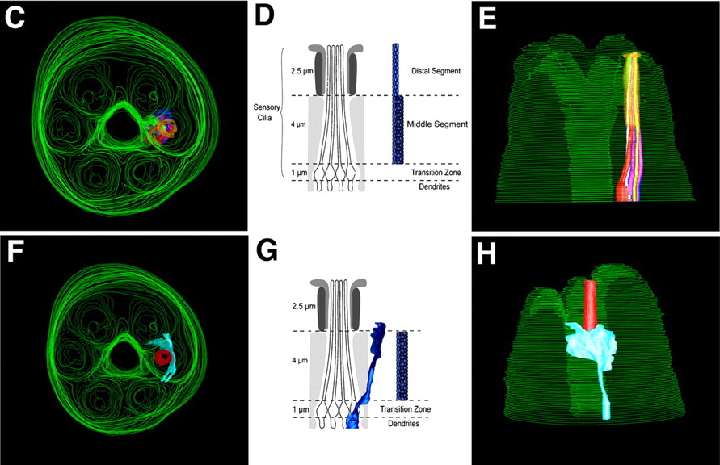

Mouth & head tip microphotographs and reconstruction:
Evans J E et al. J Cell Biol 2006;
172:663-669

Slide 6
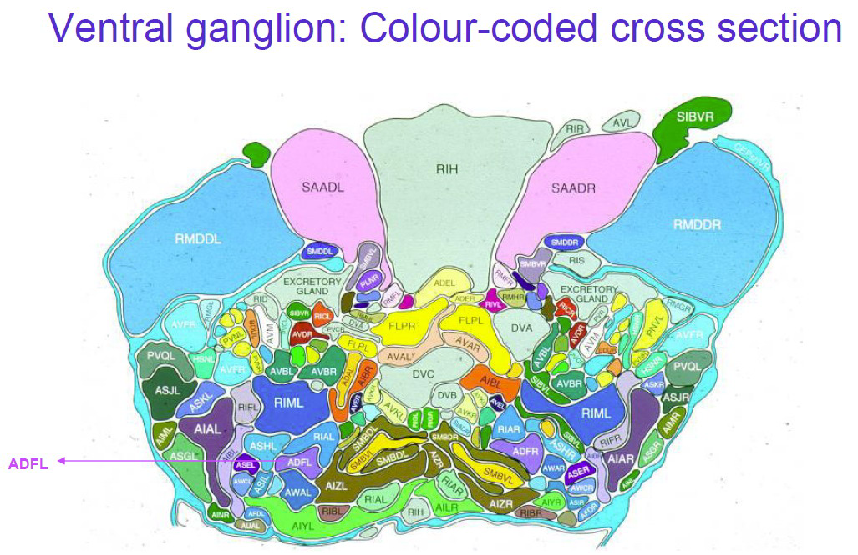

Slide 7
NEUROBIOLOGY: ON INVERTEBRATE LEARNING The following points are made by Catharine H. Rankin (Current Biology 2004 14:R617): 1) Sydney Brenner [1] introduced Caenorhabditis elegans over 35 years ago as a model system for geneticists and developmental biologists. More recently it has become an important model system for neurobiologists. In early studies on C. elegans, John Sulston et al [2,3] followed all of the cell divisions and determined the lineage of each of the 959 cells in the adult hermaphrodite. One of the important take-home messages of this work was that C. elegans development is determined -- precisely the same cell lineage pattern can be traced in every member of the species. This led to the discovery by Robert Horvitz and colleagues of genes that regulate programmed cell death [4]. 2) The unintended, and often unspoken, outcome of this Nobel Prize winning science was that researchers began to view C. elegans as a "programmed, hard-wired organism". For example, John White [5] published an enormous study using electron microscopic serial section reconstruction of the nervous system to generate a wiring diagram including all of the putative chemical and electrical synapses. In many parts of the worm diagram, only a single animal was examined and parts of a second worm used to confirm his findings. The underlying assumption for this was that the wiring diagram would be the same for all worms. Taken together the cell lineage data and the nervous system reconstruction gave the impression that the 302-neuron nervous system of C. elegans is "hard-wired". 3) Until 1990, no one investigated the possibility that C. elegans might show behavioral plasticity and be able to learn from experience. This has changed dramatically over the last 14 years. Now, instead of asking what can a worm learn? it might be better to ask what cannot a worm learn? Since the first paper focusing on learning and memory in C. elegans, there have been a large number of papers that have shown that rather than being strictly hard-wired, C. elegans is exquisitely designed to benefit from its experience, and to learn and remember a variety of different types of information about its environment. 4) These studies have shown that C. elegans can learn about mechanosensory input, chemosensory input, and thermosensory input. The worm can learn to approach or avoid tastes, odors or temperatures that predict the presence or absence of food. The worm shows non-associative forms of learning, such as habituation and dishabituation, as well as associative forms of learning, such as classical conditioning and differential classical conditioning. And the worms show both short-term and long-term forms of memory. References: 1. Brenner, S. (1974). The genetics of Caenorhabditis elegans. Genetics 77, 71-94 2. Sulston, J.E., Schierenberg, E., White, J.G., and Thomson, N. (1983). The embryonic cell lineage of the nematode Caenorhabditis elegans. Dev. Biol. 84, 64-119 3. Sulston, J.E. and Horvitz, H.R. (1977). Post-embryonic cell lineages of the nematode Caenorhabditis elegans. Dev. Biol. 56, 110-156 4. Horvitz, H.R. and Sulston, J.E. (1980). Isolation and characterization of cell-lineage mutants in the nematode Caenorhabditis elegans. Genetics 96, 435-445 5. White, J.E., Southgate, E., Thomson, J.N., and Brenner, S. (1986). The structure of the nervous system of the nematode Caenorhabditis elegans. Phil. Trans. R. Soc. Lond. B 314, 1-340

Slide 8
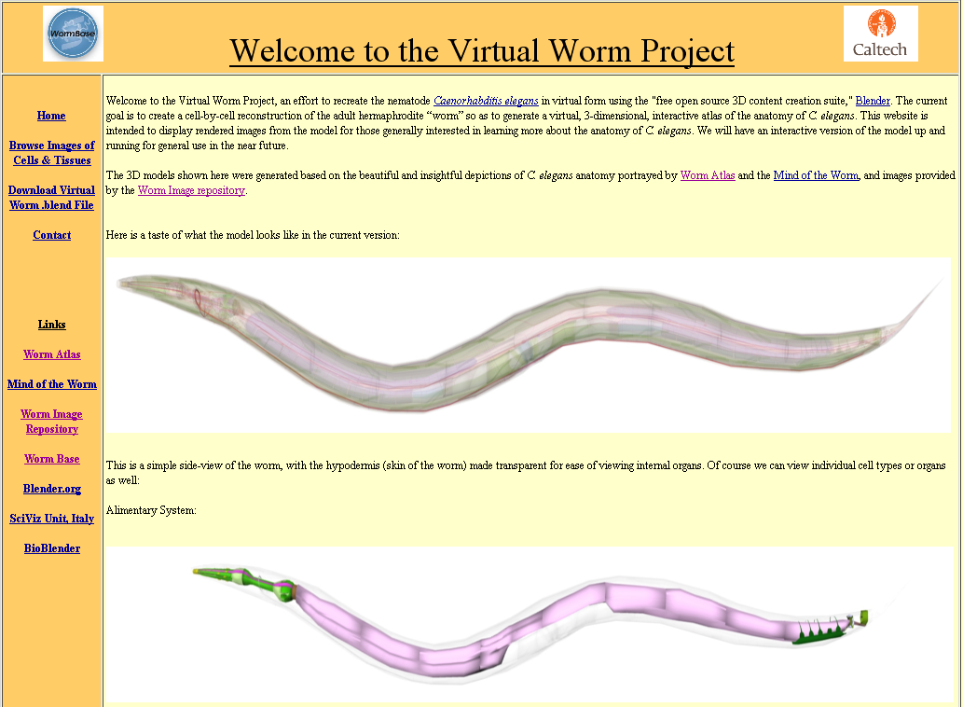
http://caltech.wormbase.org/virtualworm/

Slide 9
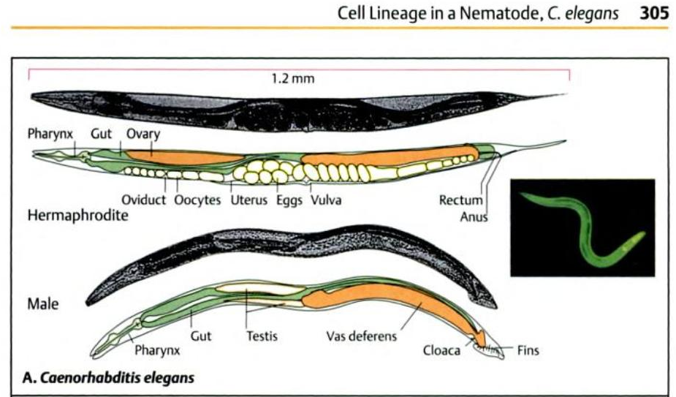
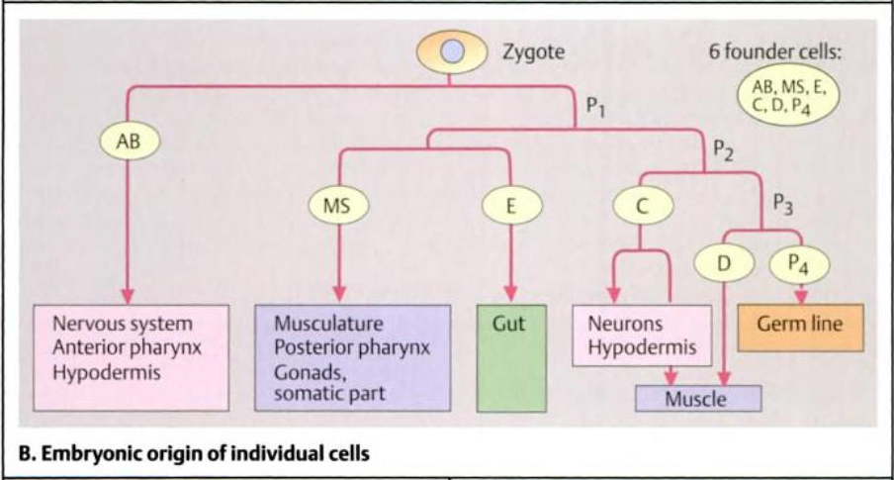

Slide 10
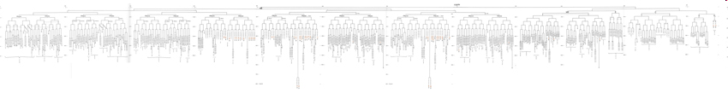
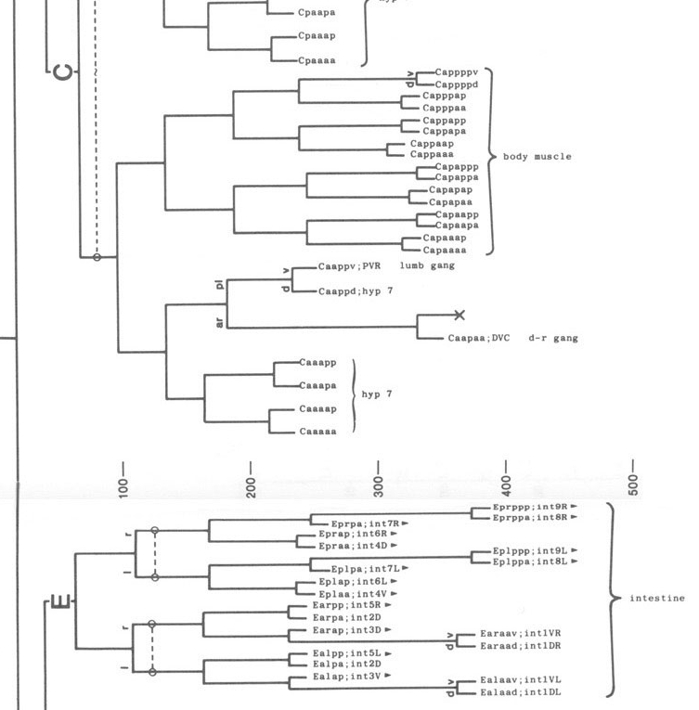
Full cell lineage description:
http://www.wormatlas.org/celllineages.html
individual cell name
Small fragment (example)
cell group (type)

